Slide 1
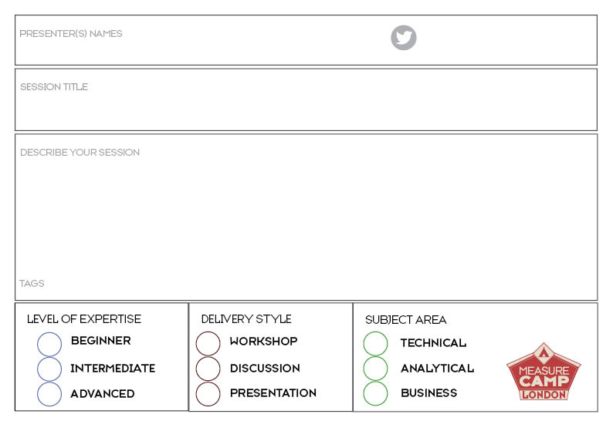




Write here
Write here
Write here
Write here.
Ticks to move into the right boxes

